Slide 1

Class Report
ppt制作：万思普
演讲者：万思普

Slide 2
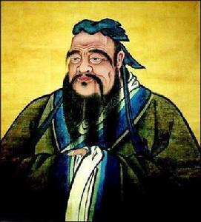
Confucian culture
Confucius, whose given name was Qiu, styled Zhongni.He was born in Lu State in late Spring and Autumn Period.When Confucius was young, he had been a senior official in the State of Lu. He was very good at governing the country. Many corrupt officials fled to other countries.But he spent most of his life teaching, and legend has it that he enrolled as many as three thousand students, turning out many students with knowledge and talent.
The founder of Confucian culture：Confucius
为天下储人才，为国家图富强

Slide 3

The classic works of Confucianist
The Confucian classics mainly include the thirteen Confucian classics.There are six Confucian scriptures, the Book of Songs, the Book of History, the Book of Rites, the Book of Music, the Book of Changes, and the Spring and Autumn Annals.In the Tang Dynasty, the Book of Rites of the Zhou Dynasty, Book of Rites, Book of Gongyang in Spring and Autumn Period, Book of Guliang in Spring and Autumn Period, and Book of Erya were added.In the Song Dynasty, Mencius was added.
为天下储人才，为国家图富强
The Book of Songs

Slide 4

Core content
The core of Confucianism is benevolence and propriety.Benevolence means to love others, and to carry out benevolent policies with the heart of "lovers" so that people at all levels of society can enjoy the right to live and be happy.Li is the moral order of the society.
为天下储人才，为国家图富强

Slide 5
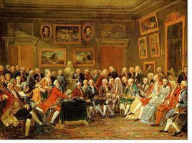
Cultural influence
Confucianism occupies an important position in the history of Chinese culture.Confucian classics are not only the tool of ideological rule, but also the main body of Chinese feudal culture, which preserves the rich national cultural heritage.Confucianism occupies an important position not only in China but also in the East Asian world.Confucianism, like Chinese characters, decrees and Buddhism, spread to the surrounding countries early and exerted an important influence on the thinking and culture there.In Korea and Japan, ethics and etiquette were influenced by Confucian ideas of benevolence, righteousness, and propriety, which are still evident today. Confucianism propelled the European Enlightenment
European Enlightenment
为天下储人才，为国家图富强

Slide 6

Taoism
制作人：孙留羿

Slide 7
Difference Between “道家”和“道教”
道家是一种哲学流派，道教是一种宗教信仰，
Taoism is a philosophical school, but Taoism is a religious belief.
(Philosophical Taoism（道家）和Religious Taoism（道教）)
到了汉武帝采纳大儒董仲舒的建议，“罢黜百家，独尊儒术”之后，
When Emperor Wudi of the Han Dynasty adopted the advice of the great Confucian Dong Zhongshu, After the overthrow of all schools of thought and the sole respect for Confucianism,
黄老之说由朝廷走向民间，与方仙道合流成黄老道，由政治信仰一变而为宗教团体。
the theory of Huang Lao moved from the imperial court to the people, and merged with the Fangxian Taoism into Huang Lao Taoism, and became a religious group from a political belief.
道教脱胎于道家。道教的思想理论来源非常复杂，远非传统的老庄之学所能涵盖。
Taoism was born out of Taoism. The ideological and theoretical sources of Taoism were very complex, which was far beyond the scope of the traditional Lao Zhuang school

Slide 8
Basic Knowledge of Taoism
道家思想的核心是天人合一 无为而治,
The core of Taoist is the oneness Virtual to assert Laissez-faire,
春秋时期, 形成了道家完整的系统理论,学说以道为最高哲学范畴,
the spring and autumn period, formed the Taoist theory of complete systems,
认为道是世界的最高真理,道是宇宙万物的本源,
theory of tao as the highest category of philosophy, think that is the world's highest truth, tao is the origin of the universe,
道是宇宙万物赖以生存的依据
tao is the survival of the universe

Slide 9
Confucian 儒家
Scriptures 经文
Rites 仪式
Mencius 孟子
Benevolence 仁慈
Propriety 礼仪
Moral 道德
ideological 意识形态的
Feudal 封建的
Heritage 遗产
Decrees 法令
Etiquette 礼节
Righteousness 正义
Propell 推动
Enlightenment 启蒙
Laissez-faire 自由放任主义
Sole 唯一的

Slide 10
Thank you
为天下储人才，为国家图富强

